Slide 1
text
Taught by Yossef Ayman Zedan

Slide 2
Text alignment
Easily realign text to components with text alignment classes. For start, end, and center alignment, responsive classes are available that use the same viewport width breakpoints as the grid system.
<p class="text-start">Start aligned text on all viewport sizes.</p> <p class="text-center">Center aligned text on all viewport sizes.</p> <p class="text-end">End aligned text on all viewport sizes.</p> <p class="text-sm-start">Start aligned text on viewports sized SM (small) or wider.</p> <p class="text-md-start">Start aligned text on viewports sized MD (medium) or wider.</p> <p class="text-lg-start">Start aligned text on viewports sized LG (large) or wider.</p> <p class="text-xl-start">Start aligned text on viewports sized XL (extra-large) or wider.</p>

Slide 3
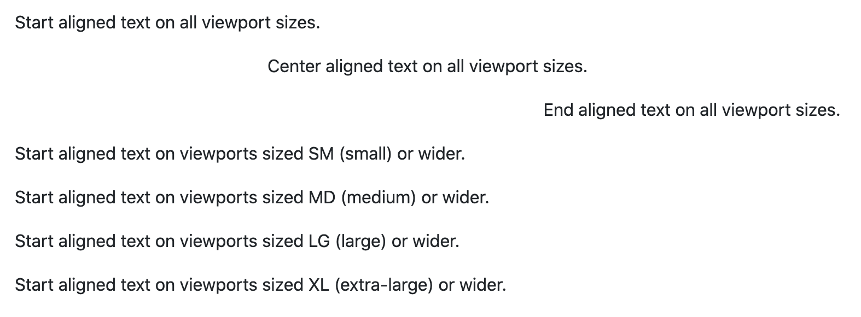
Text alignment

Slide 4

Text wrapping and overflow
Wrap text with a .text-wrap class.
<div class="badge bg-primary text-wrap" style="width: 6rem;"> This text should wrap. </div>

Slide 5

Text wrapping and overflow
Prevent text from wrapping with a .text-nowrap class.
<div class="text-nowrap bd-highlight" style="width: 8rem;"> This text should overflow the parent. </div>

Slide 6
Word break
Prevent long strings of text from breaking your components' layout by using .text-break to set word-wrap: break-word and word-break: break-word. We use word-wrap instead of the more common overflow-wrap for wider browser support, and add the deprecated word-break: break-word to avoid issues with flex containers.
<p class="text-break">mmmmmmmmmmmmmmmmmmmmmmmmmmmmmmmmmmmmmmmmmmmmmmmmmmmmmmmmmmmmmmmmmmmmmmmmmmmmmmmmmmmmmmmmmmmmmmmmmmmm</p>

Slide 7
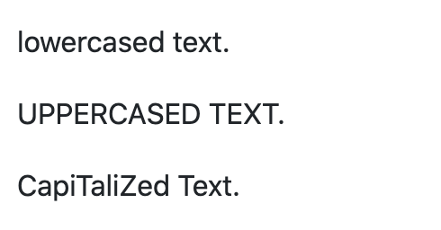
Text transform
Transform text in components with text capitalization classes.
<p class="text-lowercase">Lowercased text.</p>
<p class="text-uppercase">Uppercased text.</p>
<p class="text-capitalize">CapiTaliZed text.</p>

Slide 8
Font size
Quickly change the font-size of text. While our heading classes (e.g., .h1–.h6) apply font-size, font-weight, and line-height, these utilities only apply font-size. Sizing for these utilities matches HTML’s heading elements, so as the number increases, their size decreases.
<p class="fs-1">.fs-1 text</p>
<p class="fs-2">.fs-2 text</p> <p class="fs-3">.fs-3 text</p>
<p class="fs-4">.fs-4 text</p> <p class="fs-5">.fs-5 text</p> <p class="fs-6">.fs-6 text</p>

Slide 9
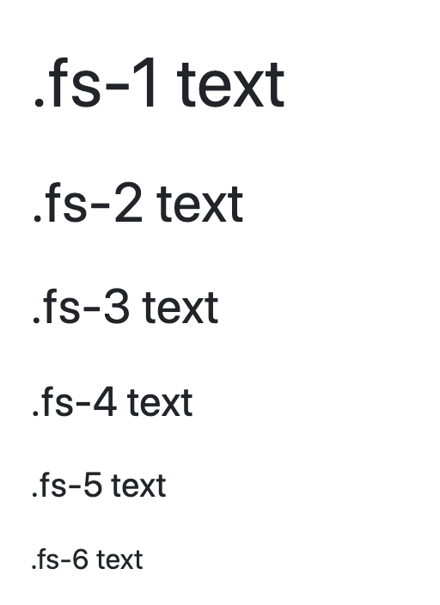
Font size

Slide 10
Font weight and italics
Quickly change the font-weight or font-style of text with these utilities. font-style utilities are abbreviated as .fst-* and font-weight utilities are abbreviated as .fw-*.
<p class="fw-bold">Bold text.</p>
<p class="fw-bolder">Bolder weight text (relative to the parent element).</p>
<p class="fw-normal">Normal weight text.</p>
<p class="fw-light">Light weight text.</p>
<p class="fw-lighter">Lighter weight text (relative to the parent element).</p>
<p class="fst-italic">Italic text.</p>
<p class="fst-normal">Text with normal font style</p>

Slide 11
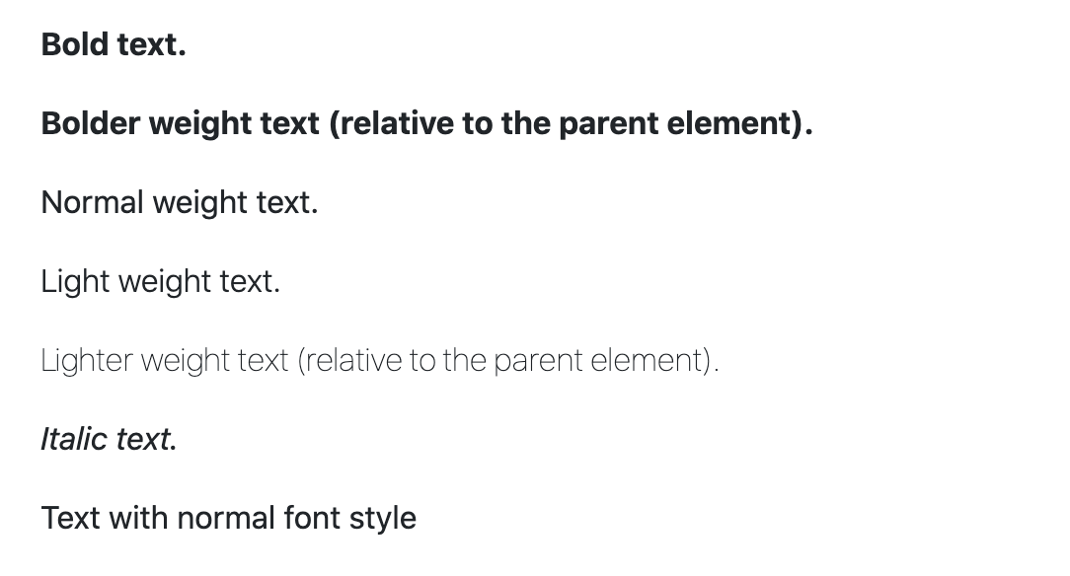
Font weight and italics

Slide 12
Line height
Change the line height with .lh-* utilities.
<p class="lh-1">This is a long paragraph written to show how the line-height of an element is affected by our utilities. Classes are applied to the element itself or sometimes the parent element. These classes can be customized as needed with our utility API.</p>
<p class="lh-sm">This is a long paragraph written to show how the line-height of an element is affected by our utilities. Classes are applied to the element itself or sometimes the parent element. These classes can be customized as needed with our utility API.</p>
<p class="lh-base">This is a long paragraph written to show how the line-height of an element is affected by our utilities. Classes are applied to the element itself or sometimes the parent element. These classes can be customized as needed with our utility API.</p>
<p class="lh-lg">This is a long paragraph written to show how the line-height of an element is affected by our utilities. Classes are applied to the element itself or sometimes the parent element. These classes can be customized as needed with our utility API.</p>

Slide 13
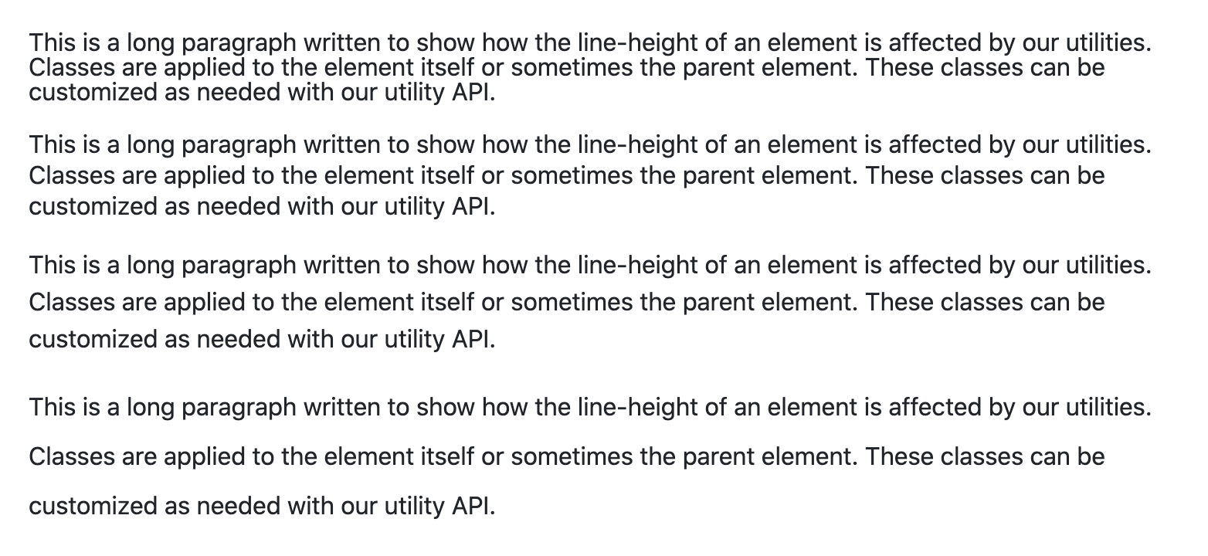
Line height

Slide 14

Monospace
Change a selection to our monospace font stack with .font-monospace.
<p class="font-monospace">This is in monospace</p>

Slide 15

Reset color
Reset a text or link’s color with .text-reset, so that it inherits the color from its parent.
<p class="text-muted"> Muted text with a <a href="#" class="text-reset">reset link</a>. </p>

Slide 16
Text decoration
Decorate text in components with text decoration classes.
<p class="text-decoration-underline">This text has a line underneath it.</p>
<p class="text-decoration-line-through">This text has a line going through it.</p>
<a href="#" class="text-decoration-none">This link has its text decoration removed</a>

